Slide 1

Micro SAAS Startup Session 1
SAAS Startup Session

Slide 2
Selecting a customer Acquisition channel 1 Define Your Objectives
Learning: Focus on gathering insights about engagement, audience interest. This is crucial for startups in early stages or expanding to new audiences.
Cost: Optimize your cost per acquisition (CPA) to maximize your budget's efficiency.
SAAS Startup Session

Slide 3
Selecting a customer Acquisition channel 2 Identify Your Constraints
Time: Is there a specific window for reaching your target audience, or are you running out of time due to financial constraints?
Financial Situation: Is your company well-financed, or are you self-funding (bootstrapping)? Do you require additional funds to sustain your operations?
Audience Focus: Is it necessary to target a highly specific group of individuals?
Legal Challenges: Are you challenging established industries with a history of legal disputes,
SAAS Startup Session

Slide 4
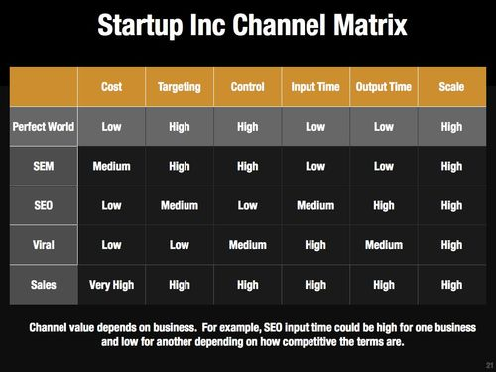
Selecting a customer Acquisition channel 3 Create a Channel Matrix
Define a way to compare channels based on similar attributes based on constraints and objectives.
”content marketing could be broken down into blogging, guest blogging, info graphics, webinars” Brian Balfour
SAAS Startup Session
5 Steps To Choose Your Customer Acquisition Channel — Brian Balfour

Slide 5
Testing an MVP
Landing Pages: First contact points for customers, also serving as MVPs for testing your product.
Ad Campaigns: Run targeted ads on platforms like Google and Facebook to gauge product appeal.
Fundraising: Use crowdfunding platforms like FundKiss to validate market interest and engage early adopters.
Explainer Videos: Showcase your product's user experience to attract early users.
Concierge MVPs: Deliver a customized service to select customers, revealing customer preferences.
Single-Feature MVPs: Focus on one core feature to simplify development and user focus.
Pre-Order Pages: Present your product to potential customers, enticing them to purchase before it's built.
SAAS Startup Session

Slide 6
Improving a Business Plan
Conduct Comparative Analysis:
Analyze Financial Projections:
Create thorough financial projections that encompass startup and operational costs, including production expenses, business running costs, and overhead.
include a comparative analysis that examines indirect competitors and alternative choices customers make.
SAAS Startup Session

Slide 7
Micro SAAS Best practices for startups
Avoid offering free trials.
Prioritize upfront cash payments, with a preference for longer commitments
Steer clear of monthly subscription models.
Directly target the decision-maker when selling your product or service,
If a trial is necessary, limit its duration,
with preference for shorter periods (1 day or 1 week).
(2 years, 1 year, 6 months).
rather than relying on their subordinates.
SAAS Startup Session

Slide 8
Cutting costs
"Software hosting and database — Managed with free credits from AWS Activate + Azure Bizspark.
Authentication service with Auth0, free upto 7000 users.
Google Analytics for clickstream analytics.
Loggly — used the free plan for log analysis.
ElasticEmail offers upto 150k free emails a month.
Msg91 for startups — Received free credits for sending transactional SMS.
CRM — Free plan with Zoho.
Calendly — for scheduling meetings.
Asana — for task management "
Here’s how we built and launched a SaaS startup for INR 2.6 lakhs | by Abishek Baskaran | Startups & Venture Capital (startupsventurecapital.com)
SAAS Startup Session

